Slide 1
SARS-CoV-2 and COVID-19
Remdesivir: Mechanism of Action
David H. Spach, MD Professor of Medicine Division of Infectious Diseases
University of Washington
Last Updated: June 12, 2020

Slide 2
Acknowledgments
The Remdesivir: Mechanism of Action Slide Set is a collaborative effort between the University of Washington Infectious Diseases Education and Assessment (IDEA) Program and Cognition Studio, Inc.
Project Design and Content Development
David Spach, MD (University of Washington) and Cognition Studio, Inc.
Medical Illustrations
Dani Bergey, MS (Cognition Studio, Inc.)
David Ehlert, MAMS, CMI, FAMI (Cognition Studio, Inc.)
Expert Content Review
Stephanie Carnes, PhD Clinical Microbiology Fellow Department of Laboratory Medicine University of Washington
Maria L. Agostini, PhD Postdoctoral Fellow Pediatric Infectious Diseases Vanderbilt University Medical Center

Slide 3
Use of the Remdesivir: Mechanism of Action Slide Set
The Remdesivir: Mechanism of Action Slide Set is licensed under a Creative Commons Attribution 4.0 International License.
No permission is required, reusers may distribute or adapt the material for noncommercial purposes only, and must include the following attribution:
University of Washington IDEA Program: Covid-19 Treatment (https://covid.idea.medicine.uw.edu)

Slide 4
SARS-CoV-2 RdRp and RdRp Complex

Slide 5
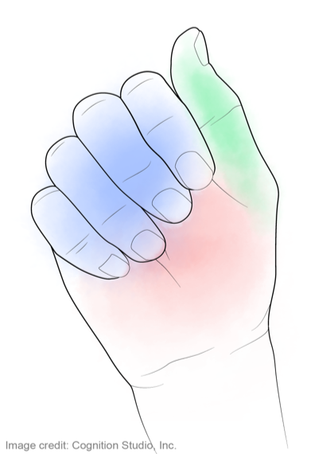
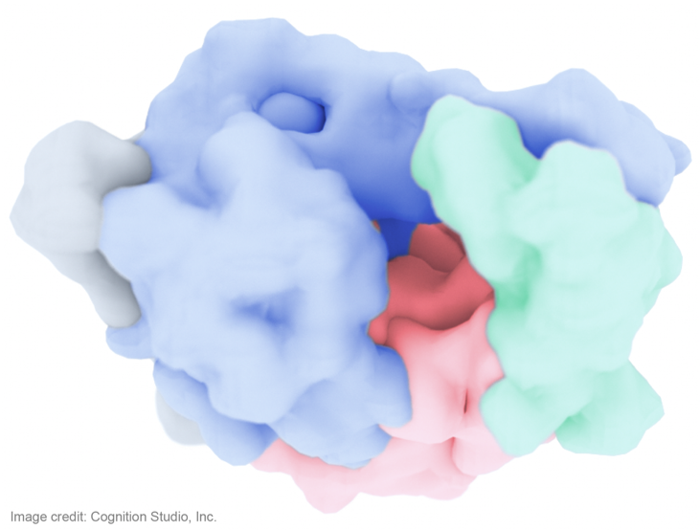
SARS-CoV-2 RNA-Dependent RNA Polymerase (RdRp): nsp12
Fingers
Thumb
Palm

Slide 6
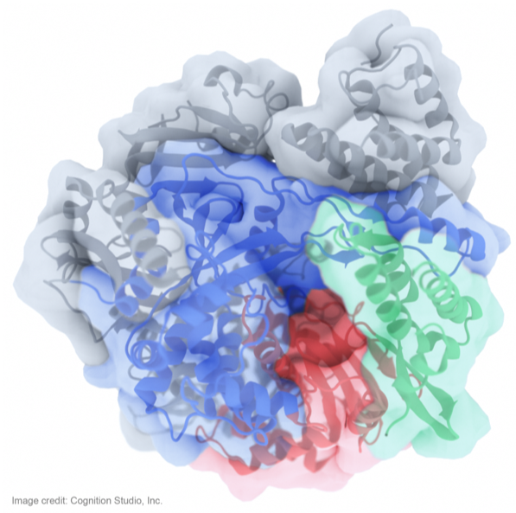
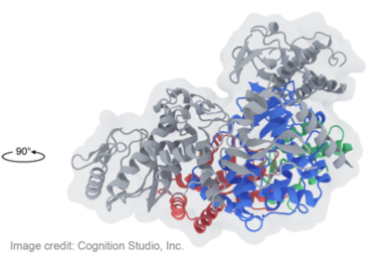
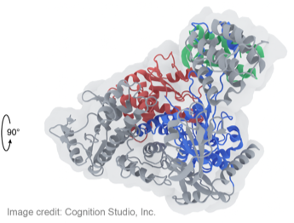
SARS-CoV-2 RNA-Dependent RNA Polymerase (RdRp) Complex: nsp7, nsp8, and nsp12
A
nsp7
nsp8
A
Fingers
Thumb
B
D
C
C
Palm
D
A
Relevant Structural Features
Cofactors nsp7 and nsp8 associate with nsp12 and are required for polymerase activity.
The active site (and nucleotide binding positions) of nsp12 is situated within the Palm subdomain of nsp12.
A nidovirus-unique N-terminal extension domain adopts a nidovirus RdRp-associated nucleotidyltransferase (NiRAN) architecture. An Interface domain connects the NiRAN and RdRp domains.
An N-terminal hairpin exists at the N terminus of nsp12 and inserts into the groove clamped by the NiRAN domain and Palm subdomain, thereby stabilizing the structure.

Slide 7
SARS-CoV-2 RNA-Dependent RNA Polymerase (RdRp) Complex: nsp7, nsp8, and nsp12
A
nsp7
A
nsp8
D
C
C
Fingers
Thumb
D
B
A
Palm

Slide 8
SARS-CoV-2 RdRp Complex and SARS-CoV-2 Genome Replication

Slide 9
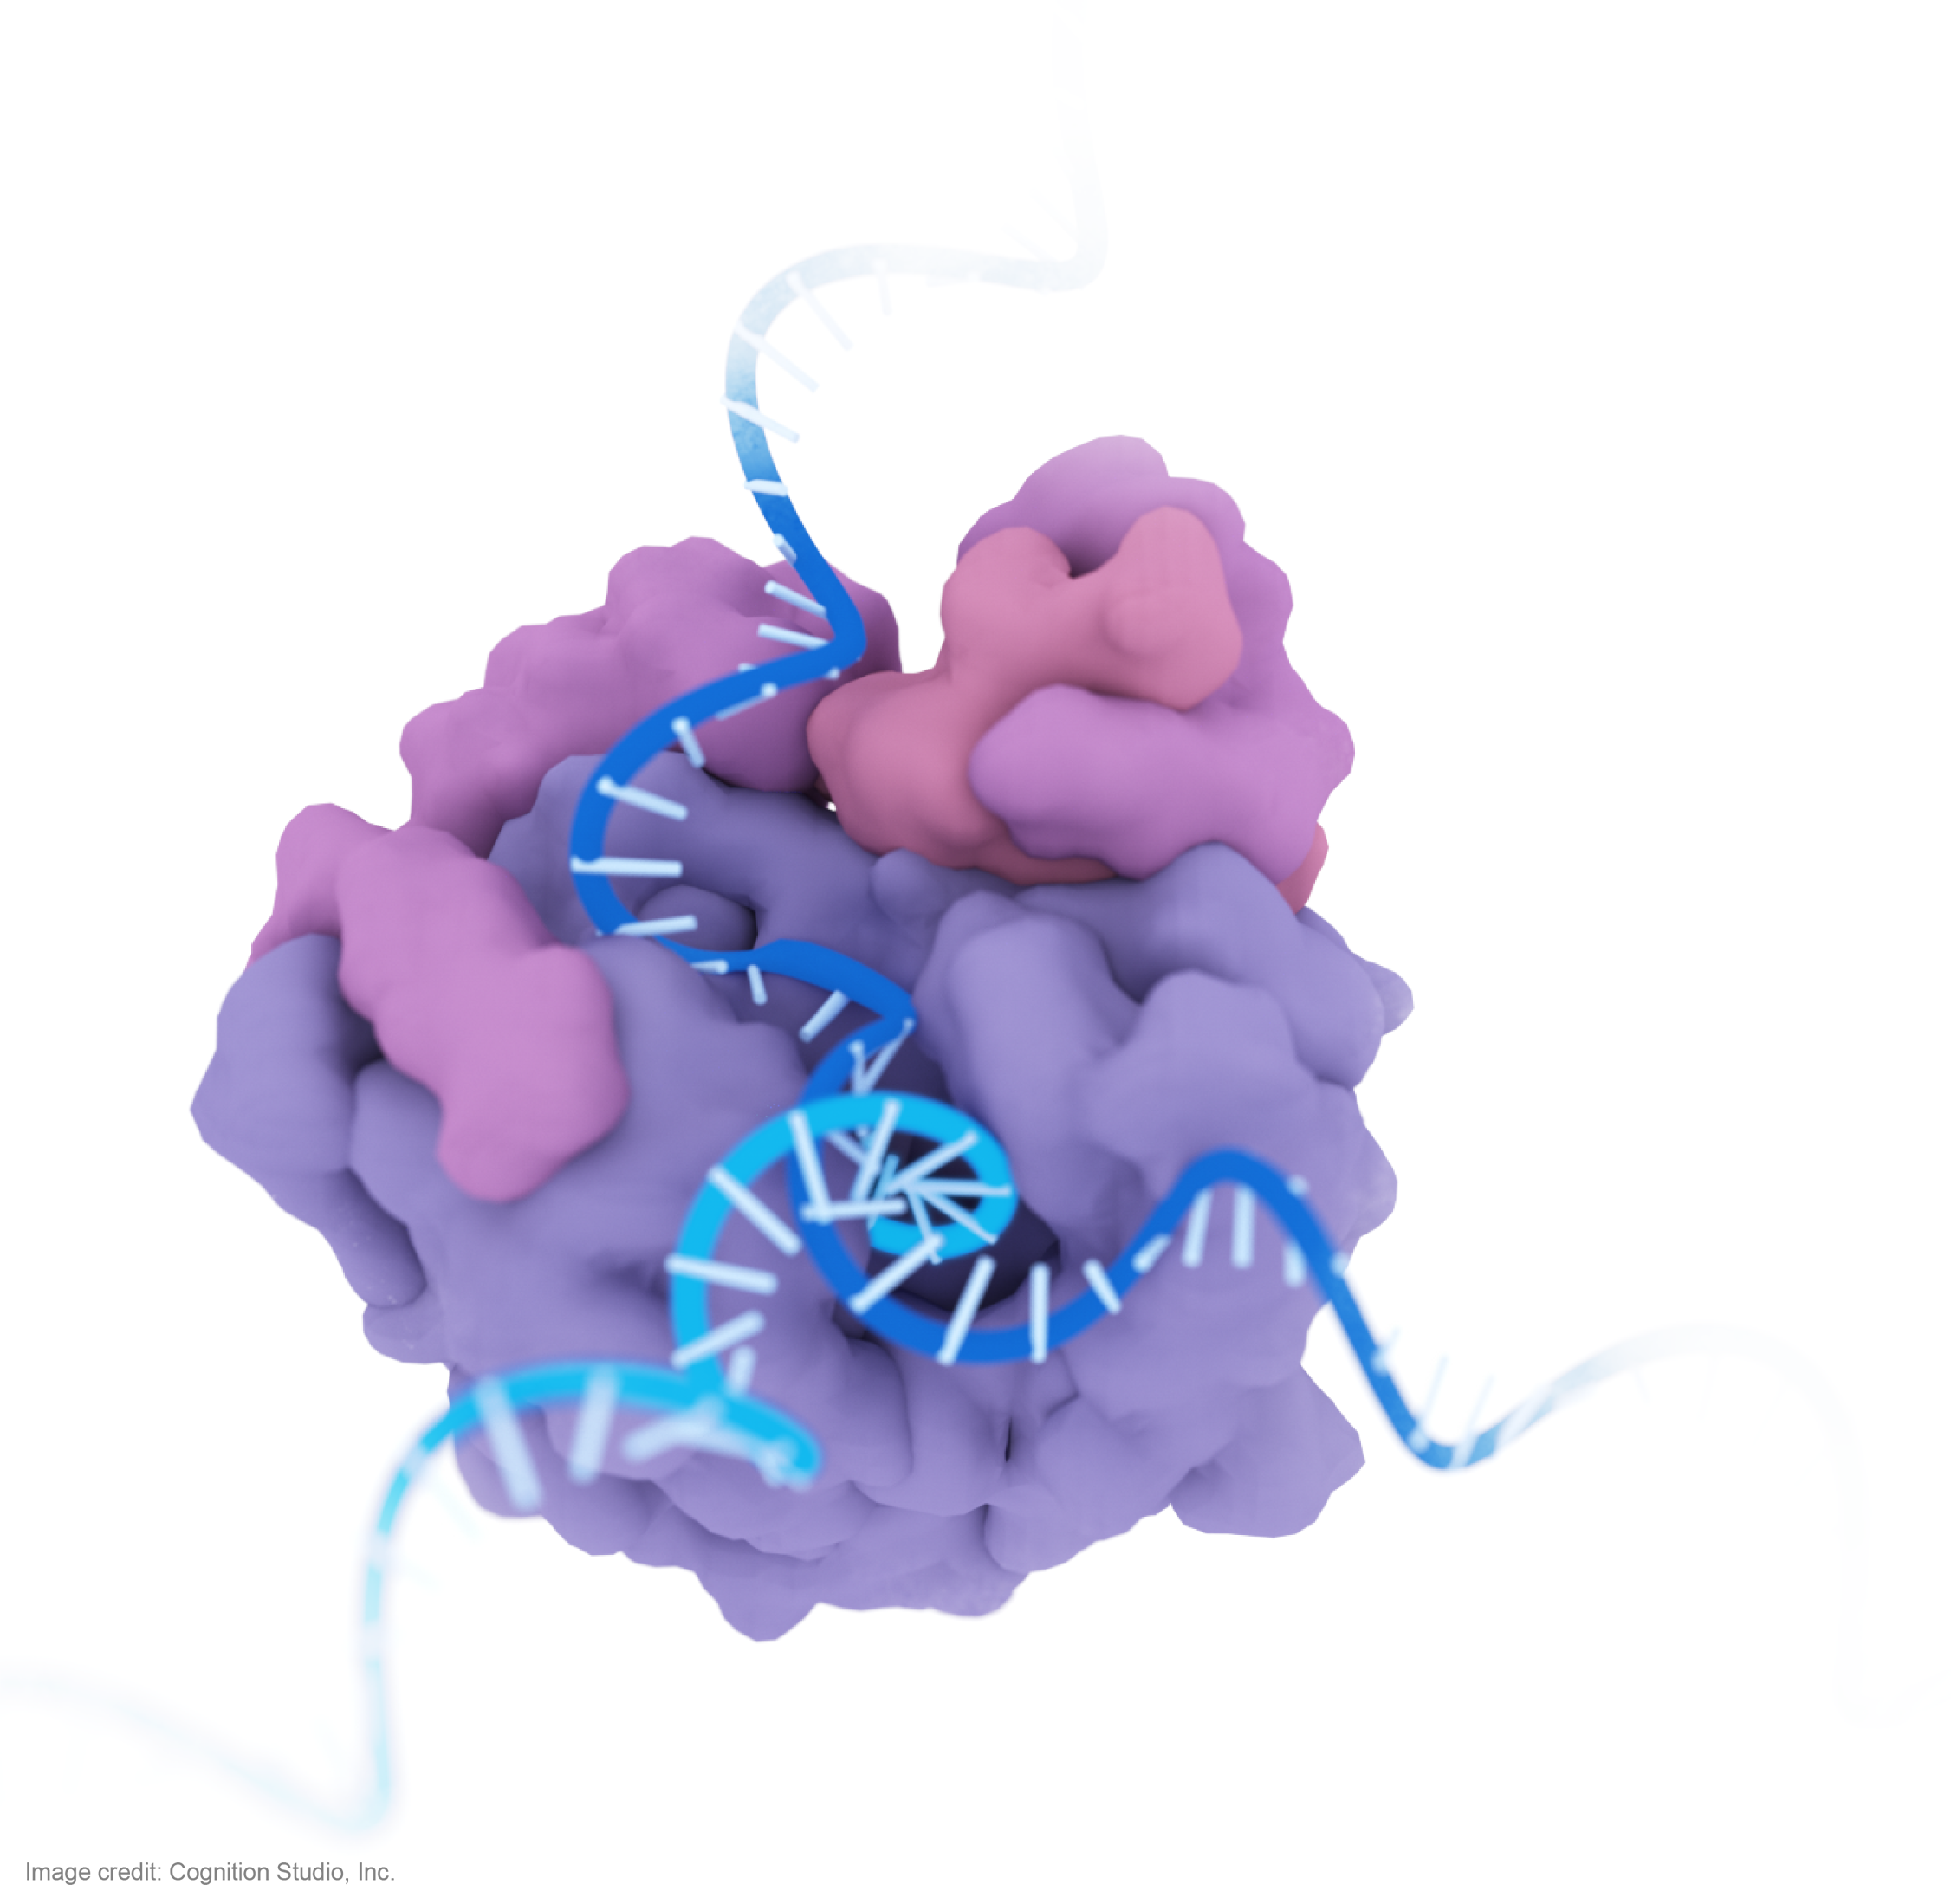
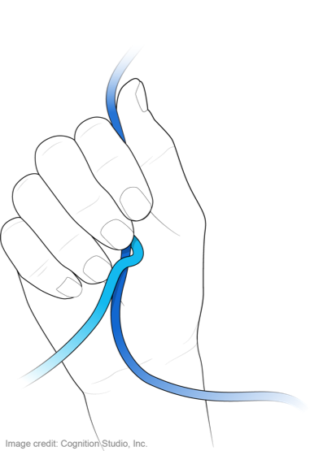
SARS-CoV-2 RNA-Dependent RNA Polymerase (RdRp) Complex: Genome Replication
(+)ssRNA, “template”
nsp7
nsp8
Fingers
Thumb
(-)ssRNA, “copy”
Palm
(+)ssRNA, “template”

Slide 10
SARS-CoV-2 RNA-Dependent RNA Polymerase (RdRp) Complex: Genome Replication
(+)ssRNA, “template”
nsp7
nsp8
Fingers
Thumb
(-)ssRNA, “copy”
Palm
(+)ssRNA, “template”

Slide 11
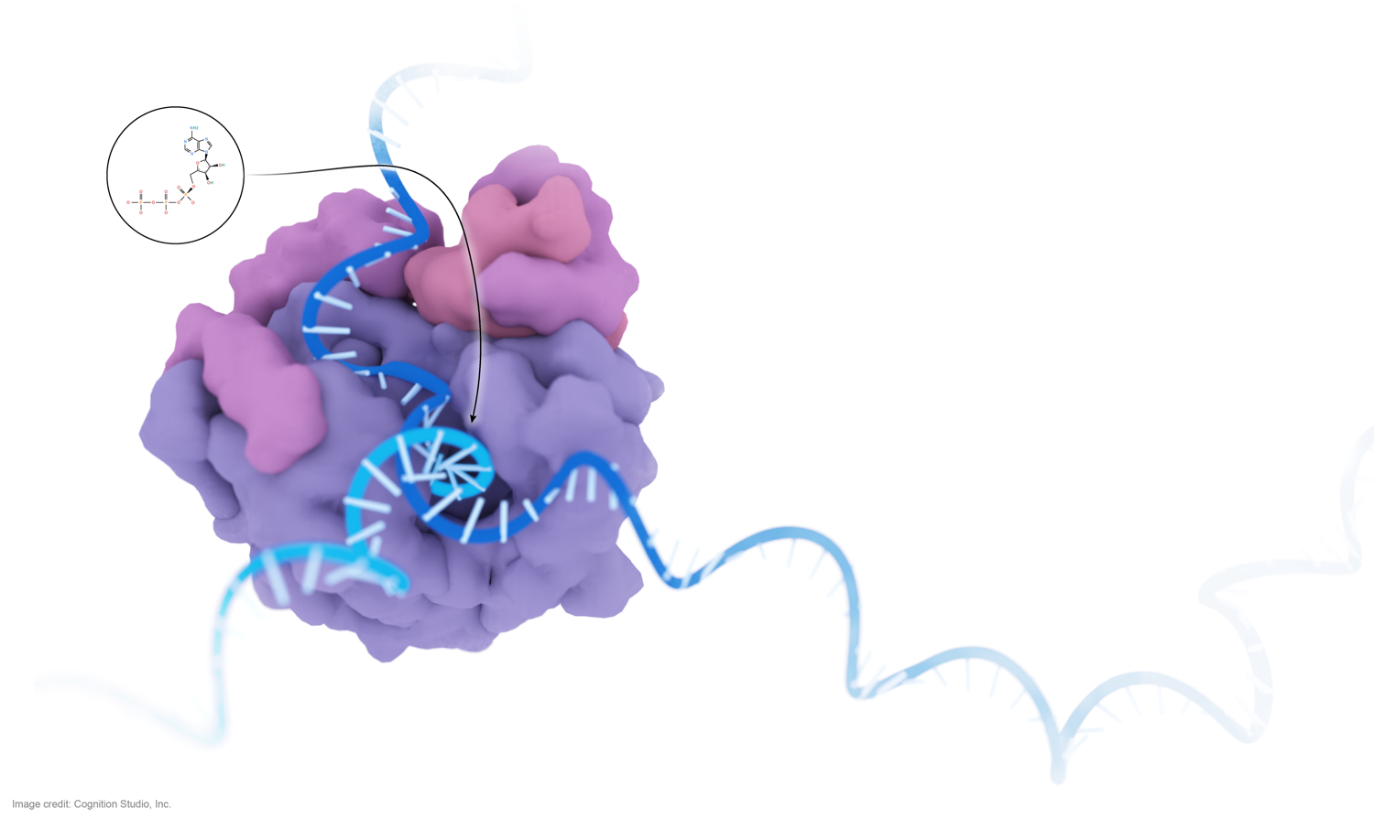
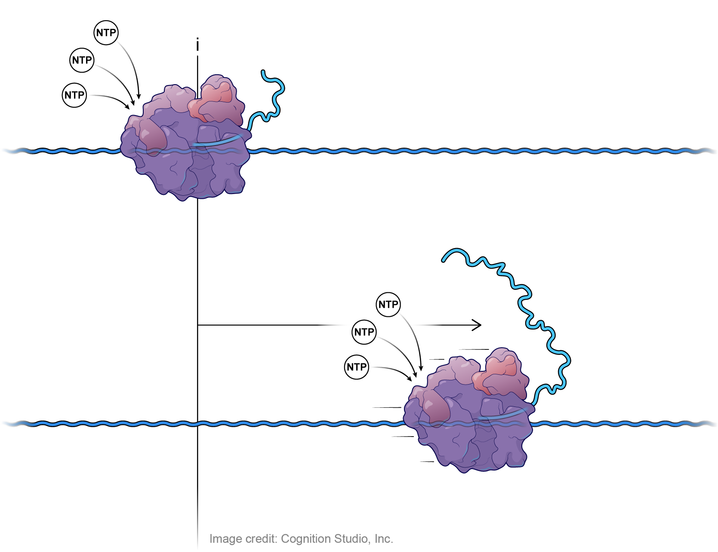
SARS-CoV-2 RNA-Dependent RNA Polymerase (RdRp) Complex: Genome Replication
NTPs are incorporated into the elongating RNA strand by the RdRp
Nucleoside triphosphate (NTP)
RdRp Complex
(-)ssRNA,“copy”
nsp7
(+)ssRNA, “template”
nsp8
RdRp Complex
Viral (+)ssRNA template entry
Fingers
Thumb
Viral ssRNA exit
(-)ssRNA, “copy”
Palm
(+)ssRNA, “template”

Slide 12
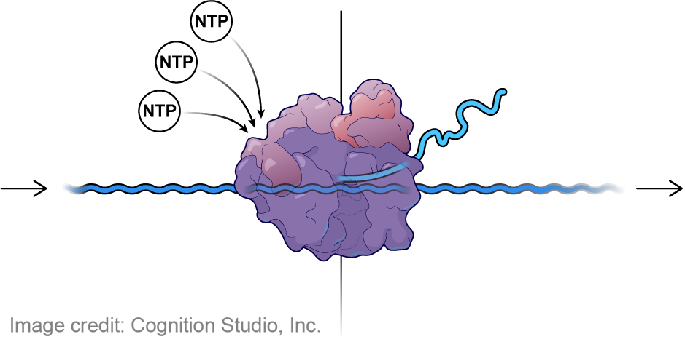
SARS-CoV-2 RNA-Dependent RNA Polymerase (RdRp): Complex: Genome Replication, Addition of Nucleoside Triphosphates (NTPs)
i = Position of nucleoside addition
Nucleoside triphosphate (NTP)
i = Position of nucleoside addition
(-)ssRNA, “copy”
(-)ssRNA,“copy”
(+)ssRNA, “template”
RdRp Complex
(+)ssRNA, “template”
Direction of RNA translocation
i+1
i+1
i+2
i+3
i+4

Slide 13
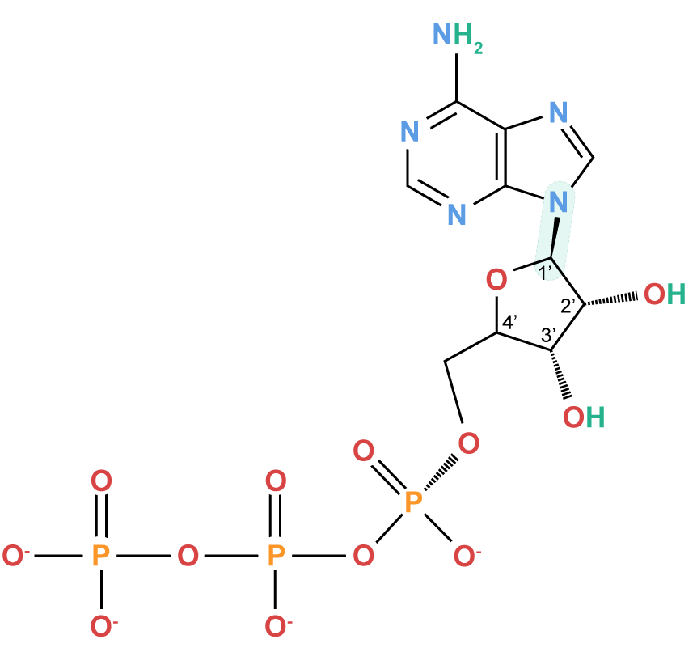
SARS-CoV-2 RNA-Dependent RNA Polymerase (RdRp) Complex: Genome Replication, Addition of Nucleoside Triphosphates (NTPs)
i = Position of nucleoside addition
Nucleoside triphosphate(NTP)
(-)ssRNA, “copy”
i = Position of nucleoside addition
(-)ssRNA, “copy”
(+)ssRNA, “template”
RdRp Complex
(+)ssRNA, “template”
Direction of RNA translocation
i+1
Adenosine triphosphate (ATP)
C-N bond
i+1
i+2
i+3
i+4

Slide 14
Remdesivir Structure

Slide 15
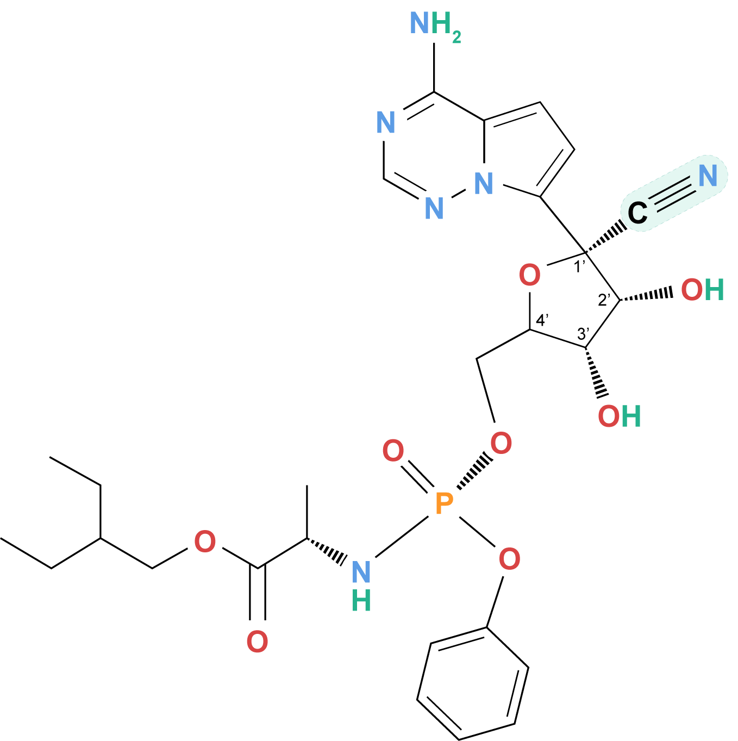
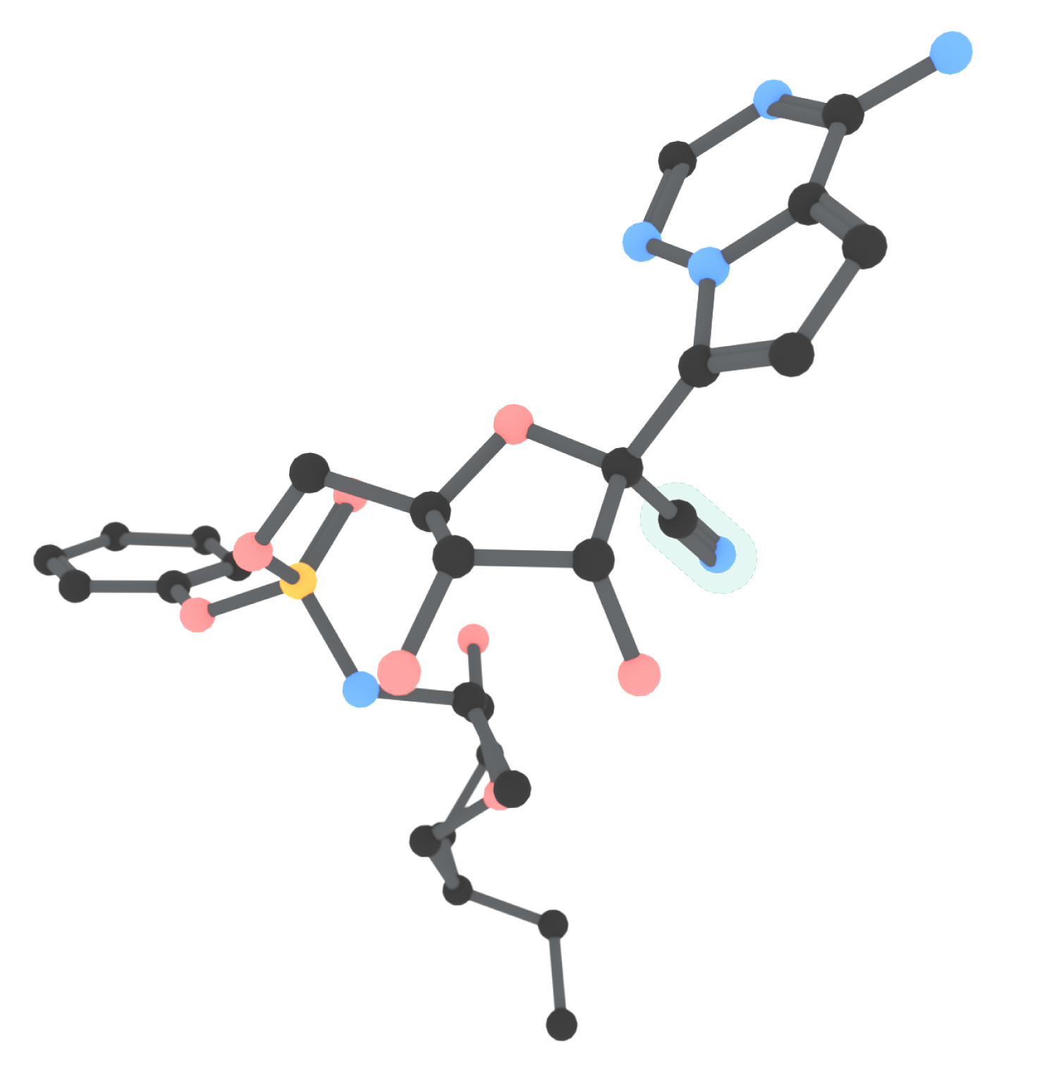
Chemical Structure of Remdesivir (prodrug)
2D view
3D view
(Hydrogen atoms removed)
1’ cyano group
1’ cyano group

Slide 16
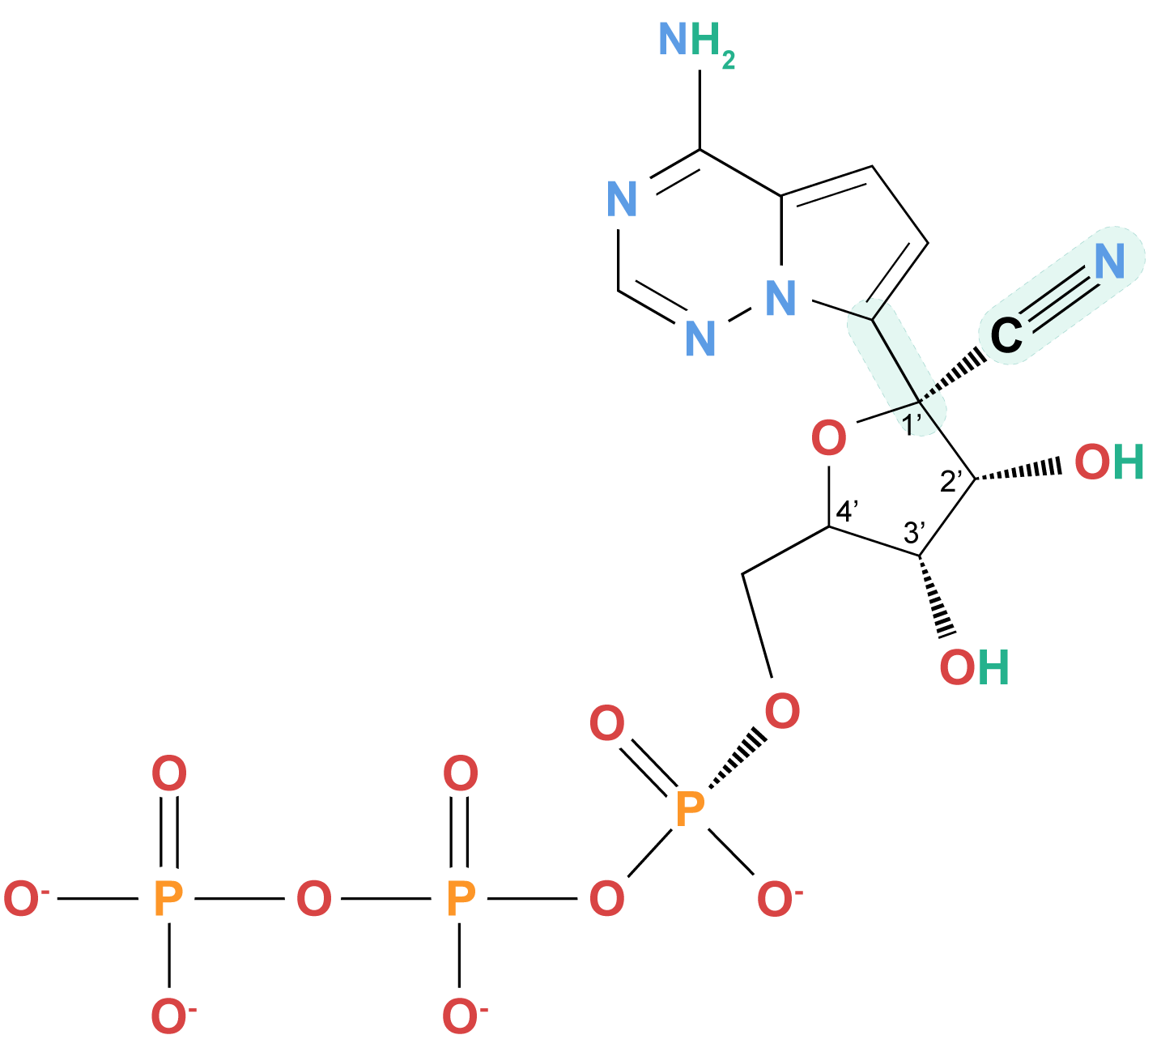
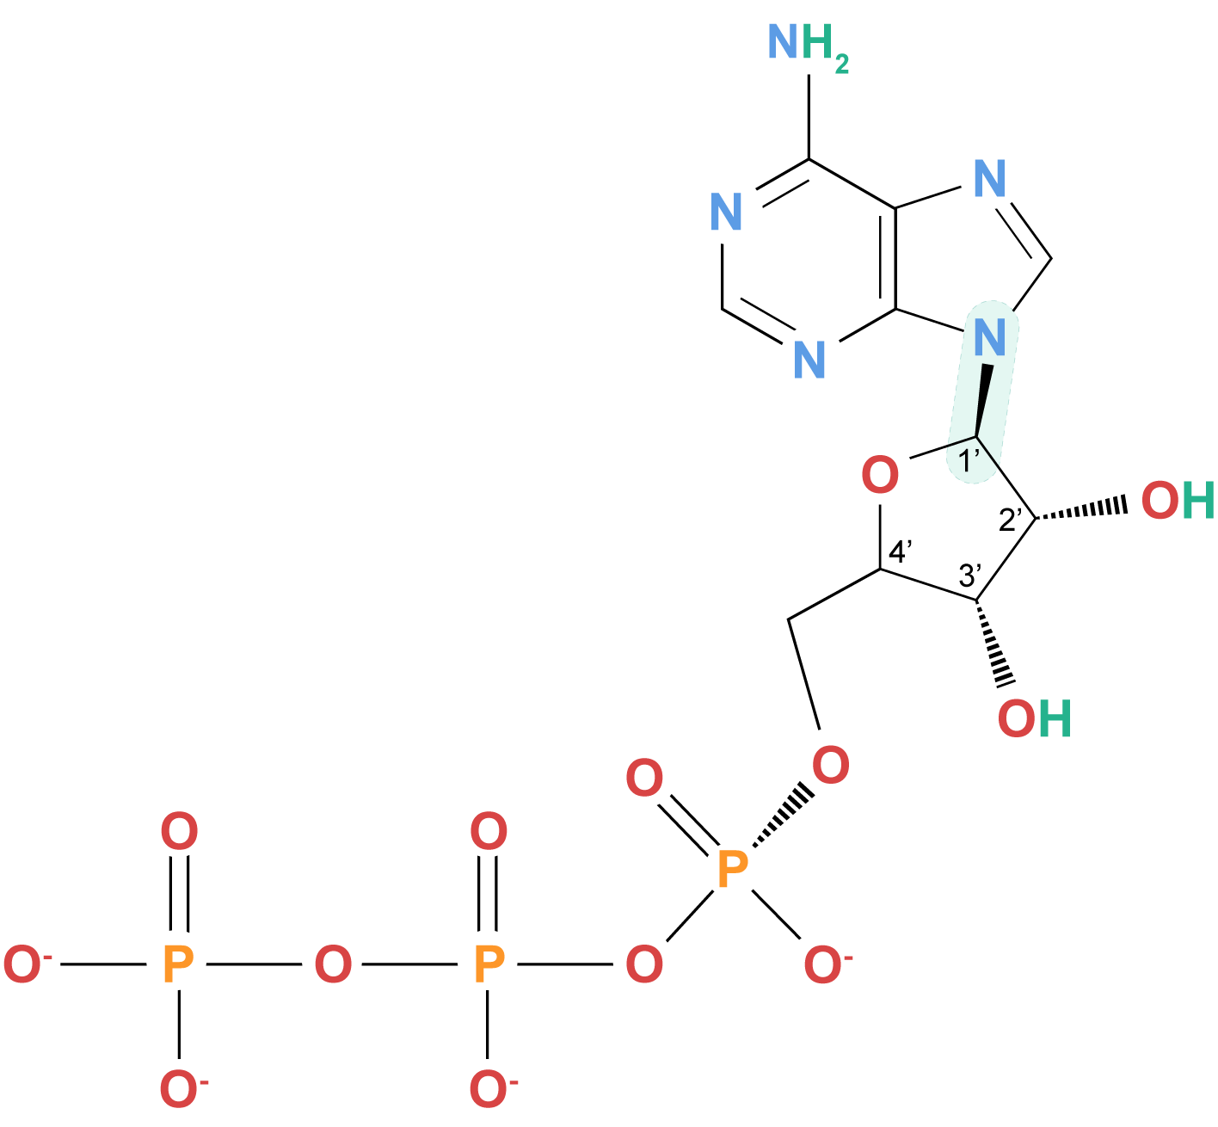
RDV-TP Compared to ATP
Remdesivir triphosphate (RDV-TP)
Adenosine triphosphate (ATP)
1’ cyano group
C-C bond
C-N bond

Slide 17
Remdesivir Activation and Inhibition of SARS-CoV-2 Genome Replication

Slide 18
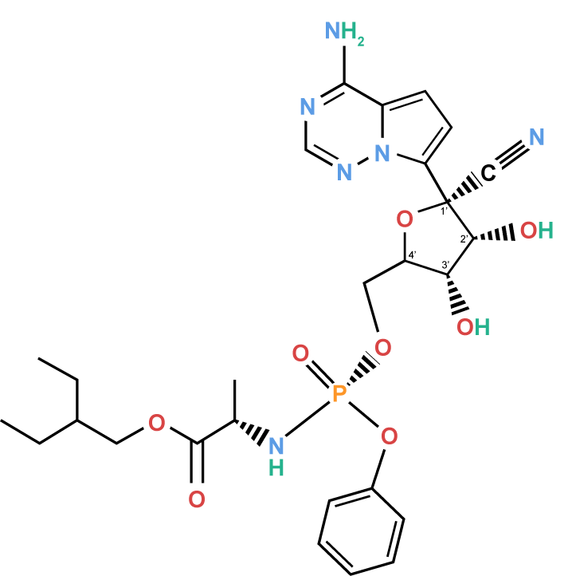
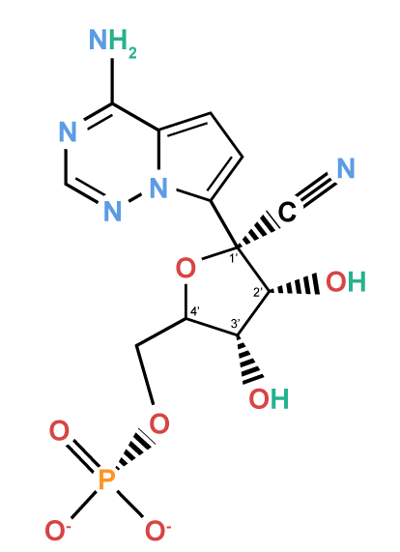
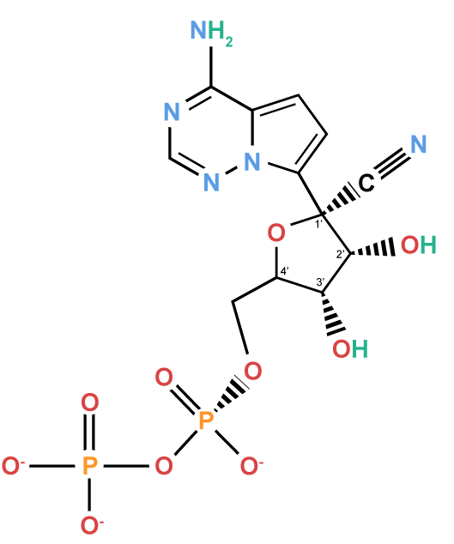
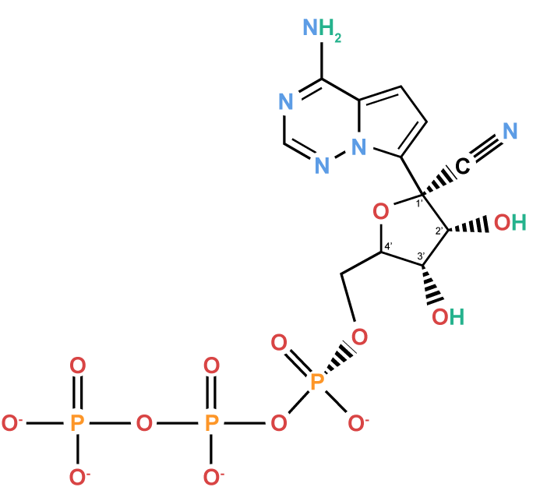
Remdesivir Activation
After diffusing through the cell membrane, the protecting groups of Remdesivir are cleaved as it is metabolized into nucleoside monophosphate. Two phosphorylation events produce the active form, referred to as Remdesivir triphosphate or RDV-TP.
Remdesivir (GS-5734)
“prodrug”
Extracellular
Cell membrane
Diffusion
Intracellular
(cytosol)
Remdesivir (GS-5734)
“prodrug”
Nucleoside monophosphate
Nucleoside diphosphate
Nucleoside triphosphate
“active drug”
Hydrolysis
Phosphorylation
Phosphorylation
Cathepsin A or other esterases cleave the protecting groups

Slide 19
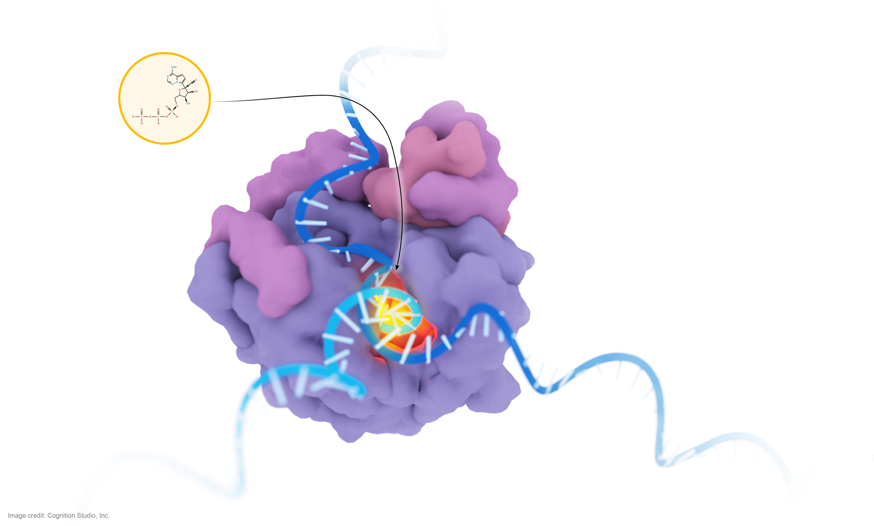
Remdesivir (RDV) Mechanism of Action: Delayed Chain Termination
Remdesivir triphosphate (RDV-TP)
RdRp Complex
RDV-TP competes with NTP
nsp7
nsp8
Viral (+)ssRNA template entry
Fingers
Thumb
Viral ssRNA exit
Palm
(-)ssRNA, “copy”
(+)ssRNA, “template”

Slide 20
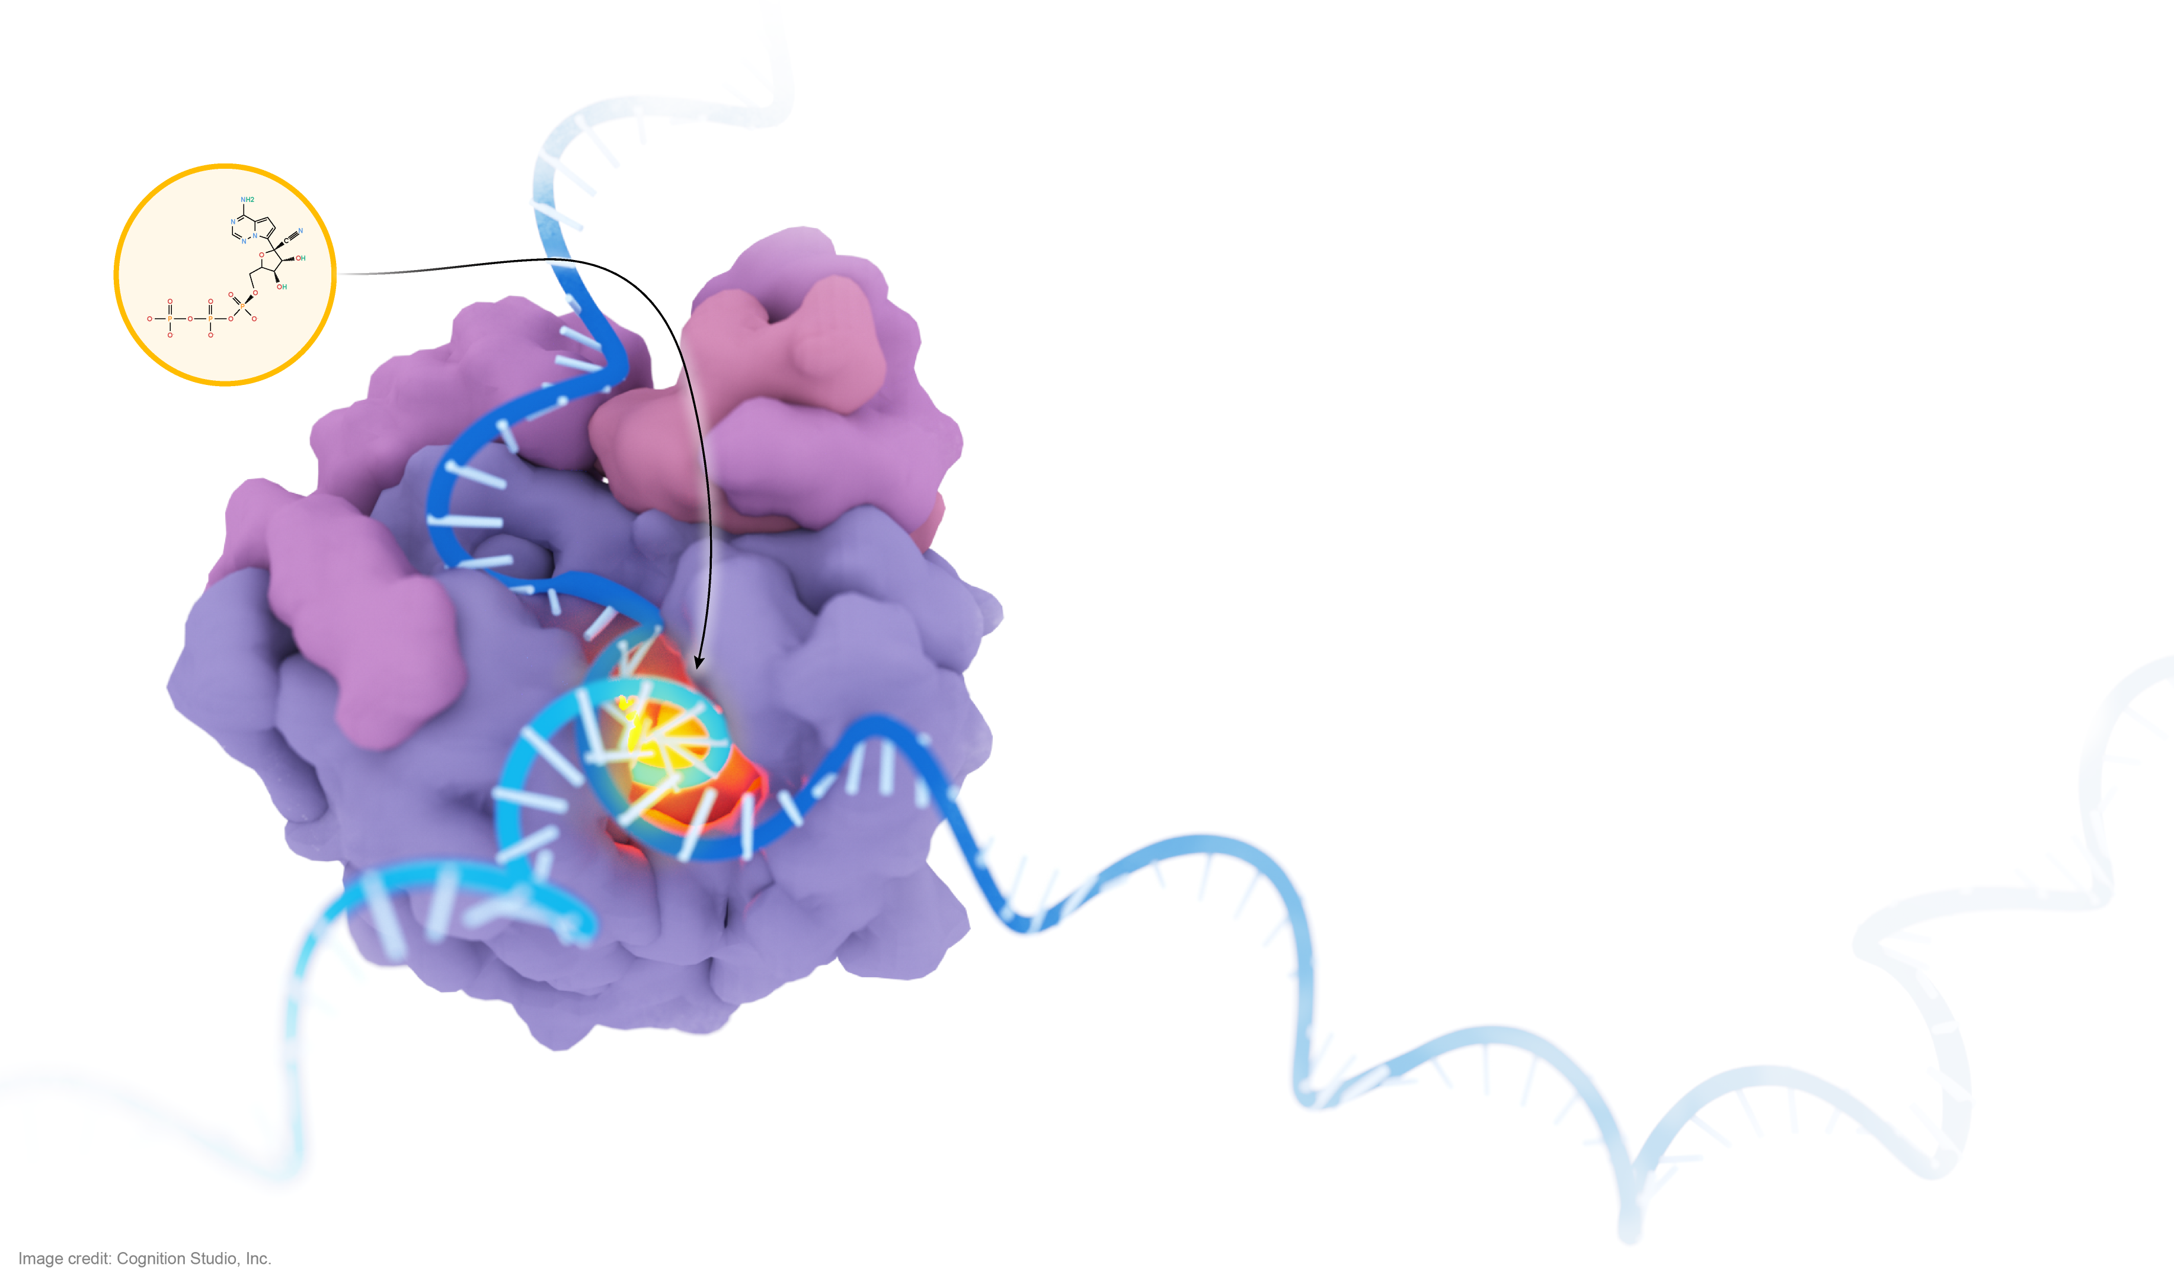
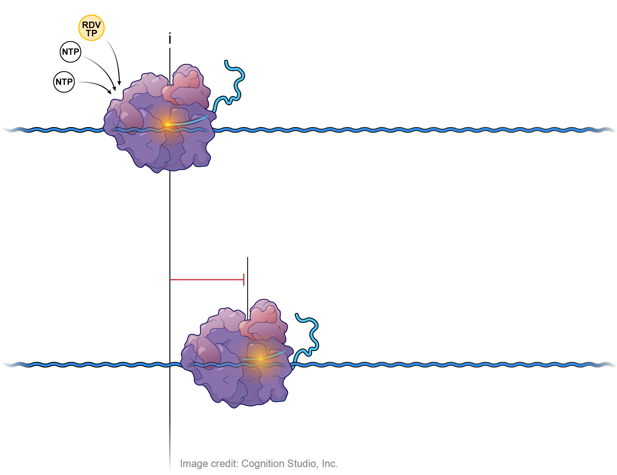
Remdesivir (RDV) Mechanism of Action: Delayed Chain Termination
RDV-TP competes with NTP
Remdesivir triphosphate (RDV-TP)
RDV-TP is more efficiently incorporated into the elongating RNA chain than ATP, but does not outcompete other NTPs
RdRp Complex
i
(-)ssRNA, “copy”
nsp7
(+)ssRNA, “template”
nsp8
RdRp Complex
Three subsequent nucleotides are added to the elongating strand before RDV-TP causes a steric clash and terminates synthesis of the RNA copy
Viral (+)ssRNA template entry
i+3
Fingers
Thumb
Viral ssRNA exit
(-)ssRNA, “copy”
Palm
(+)ssRNA, “template”
NTP: Nucleoside triphosphate

Slide 21
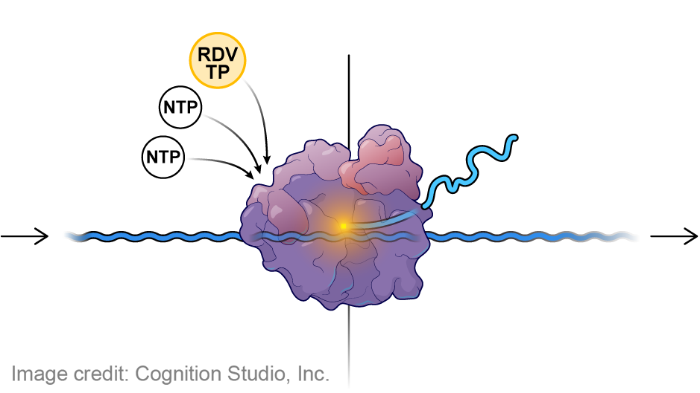
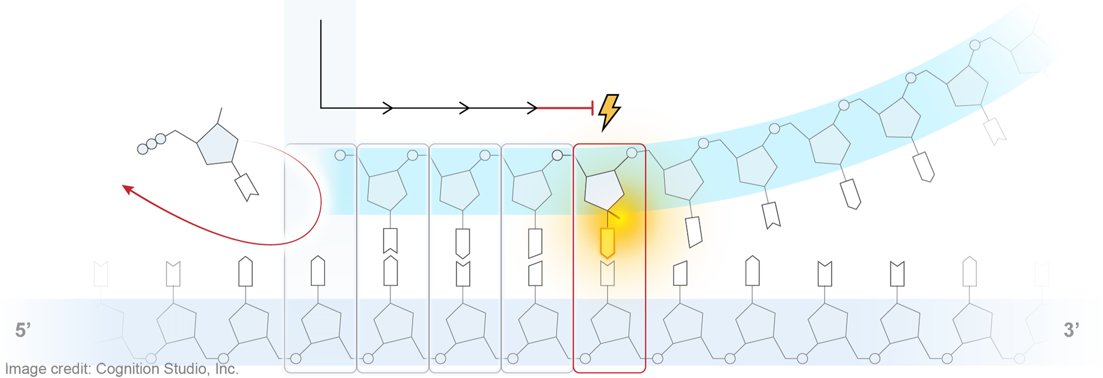
Remdesivir (RDV) Mechanism of Action: Delayed Chain Termination via Addition of RDV-TP
i = Position of nucleoside addition
Remdesivir triphosphate (RDV-TP)
(-)ssRNA, “copy”
i = Position of nucleoside addition
(-)ssRNA, “copy”
(+)ssRNA, “template”
RdRp Complex
(+)ssRNA, “template”
Direction of RNA translocation
i+1
A steric clash occurs at the i+4 position and terminates synthesis of the RNA copy
i+1
i+2
i+3
i+4

